Slide 1
Architect’s battle Team 1

Slide 2

MAJOR BUSINESS GOALS
Provide real-time analytics for customers
Support more types of devices/new features
Collect more data for advanced analytics
Speed up and simplify new customer onboarding process
Entering new market (China)
Integration with HUAWEI

Slide 3



CONSTRAINTS AND LIMITATIONS
CONSTRAINTS AND LIMITATIONS
Google Cloud has to be used
Alibaba Cloud has to be used in Middle East and for HUAWEI infrastructure
Time to market: 3 month for HUAWEI migration 24 month for SDK platform development
SLA agreement 99.99% for data gathering, 99.95% for analytics platform
Keep user data in isolated secured data storage

Slide 4
BENEFITS DEPENDENCY NETWORK
HOW
WHAT
WHY
6. Enablers
5. Capabilities
4. Changes
3. Benefits
2. Outcomes
1. Drivers
Extended SDK capabilities
Real-time analytics
Solution becomes more maintainable
Unique data ownership facilitating innovations
Timely and efficient service
Ability to provide real-time analytics
Hosting on Cloud
Ability to support new devices and features
Scalability & high availability
Increase of customer’s audience
Modernized business
Increase in competitiveness on the market
Advanced IoT management apps
Support more types of IoT devices
New insights from available data
Enhanced reputation within all types of customers
Innovative approaches to data analysis
Existing customers armed with new level of control over smart house
Integration with HUAWEI
Easy onboarding & support
New level of customer service
Expansion to new market
Advanced insights based on collected data

Slide 5




ROADMAP
Horizon 0
Horizon 1
Horizon 2
Horizon 3
Discovery
3 Month
Integration/Migration
4 Month
Implementation
15 Month
Rollout
2 Month
Analyze existing SDK documentation, analytical tools/workflows, web&mobile app
Create MVP implementation plan
Investigate capabilities of Google Cloud and Alibaba Cloud
Create integration plan for HUAWEI
Define and prioritize the MVP scope and develop roadmap
Cloud solutions are configured to support IoT operations
HUAWEI data migrated to Alibaba cloud
Existing data from NA and EU migrated to GCP
Develop SDK to support new device types
Extend existing web&mobile apps with new features
Building the SDK platform foundation for advanced analytics capabilities
Real-time integration with IoT and surveillance equipment streaming data
Finish development of extended functionality for web&mobile apps
Extending the data platform to addresses the multi-brand challenges that.
Iterative market scale rollout
Iterative market scale rollout
SCOPE HIGHLIGHTS
SDK Architecture/Concept
Low fidelity prototype for key components
Agreed & prioritized MVP scoping
Migration plan for HUAWEI solution
Integration plan with HUAWEI systems
Cloud-ready environments on Google and Alibaba are supporting IoT operations
HUAWEI data is fully migrated to Alibaba
Collected IoT data is migrated to GCP
Real time advanced data insights from collected IoT data
Extended possibilities of collected data usage
Support of innovations
Service optimization
Real time, advanced analytics
New customers are easily onboarded worldwide
Data insights are available for brand new use cases
KEY BENEFITS
Notes:
DISCOVERY
The discovery process helps the EPAM team to understand the current pain points of the business, users and technology in depth. Through analyzing any existing documentation and research and talking to key stakeholders we are better prepared to deliver recommendations that exceed a user and business’ expectations. We will review existing CDPHP research, strategy documents, business and technology architectures and conduct stakeholder discussions to understand current state and define future state.
Review all existing artifacts including existing business capabilities, architectures, strategy documents and research
Identify potential gaps in artifacts
Review existing data and metrics
Conduct Stakeholder Workshops to:
Understand Current State
Define Future State Capabilities (FSC)
Rank FSCs into High, Medium, Low priority
Conduct interviews with representative audiences
DESIGN
PLAN (ROADMAP PLANNING)
With the Future State fully defined the EPAM team will focus on creating a Roadmap that will enable the defined Future State. The team will work closely with the CDPHP Technology team to bundle similar Capabilities into a Project and a corresponding Technology Architecture and any Customer Experience prototypes. Each Project will have a priority, estimated cost and a proposed timeline. Collectively the Projects and the Future State Architecture(s) will be called the Future State Implementation Roadmap.
Bundle similar capabilities across various business units together to develop a Project. Projects may also be developed to enable 1 capability
Assign a Future State technology Architecture to the project
Determine and assign proposed cost and timeline
Determine with the CDPHP technology team if Projects would need the expansion of a current technology or the development/acquisition of a new one

Slide 6








Our Approach to Delivery
DELIVERY APPROACH
D
1
2
3
3
Discovery
Integration/Migration
Implementation
Rollout
Support
DATA ENGINEERING STREAM
CLOUD ENGINEERING STREAM
SDK/MOBILE APPS STREAM
WEB DEVELOPMENT STREAM
Work Streams

Slide 7
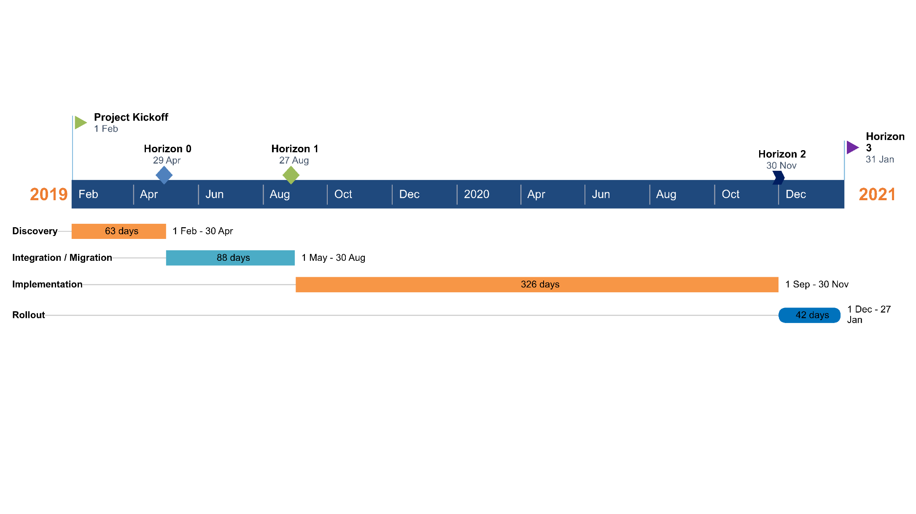
TIMELINE

Slide 8
BUDGET
Full project lifecycle is included in estimates: discovery, integration/migration, implementation and rollout.
Proposed Scrum with 2-week sprints.
Expected project duration is 2 years.
Expenses Category | Price
Development Expenses | 2 329 300
Cloud Hosting Expenses | 70 000
Total | 2 399 300

Slide 9

MIGRATION PLAN
Existing HUAWEI data is moved to Alibaba
Existing Middle East data is moved to Alibaba
EU and NA data is moved to GCP
Comply with industry security standards

Slide 10






















HUAWEI DATA ANALYTICS SOLUTION
Devices
Standard Devices HTTPS
Tenant-level Isolation
Alibaba Cloud
Storage
Browser Client
Disk Storage
Ingest
Pipelines
RDS
Application & Presentation
Cloud Pub/Sub
Cloud Dataflow
Mobile
Gateway
Container Service
Monitoring
Analytics
Stream Compute
Compute Service
Logging
WeChat payment
Analytic DB
MaxCompute
Cloud VPN

Slide 11

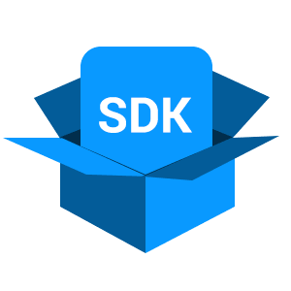
















DATA ANALYTICS SOLUTION
Devices
Standard Devices HTTPS
Tenant-level Isolation
Browser Client
Storage
Cloud Storage
Cloud Datastore
Ingest
Pipelines
Application & Presentation
Cloud Pub/Sub
Cloud Dataflow
Cloud Bigtable
Mobile
App Engine
Gateway
Monitoring
Analytics
Kubernetes Engine
Cloud Dataflow
Logging
Compute Engine
Payment
System
BigQuery
Cloud Dataproc
Cloud VPN
Cloud Datalab

Slide 12
THANK YOU FOR ATTENTION! Q&A

